Slide 1

MEJANA
Your Safety Application

Slide 2





WHO WE ARE
Marco – Technician
Jan - Manager
Nadja – Analyst
Chris - Technician
Mehmed – Creative

Slide 3
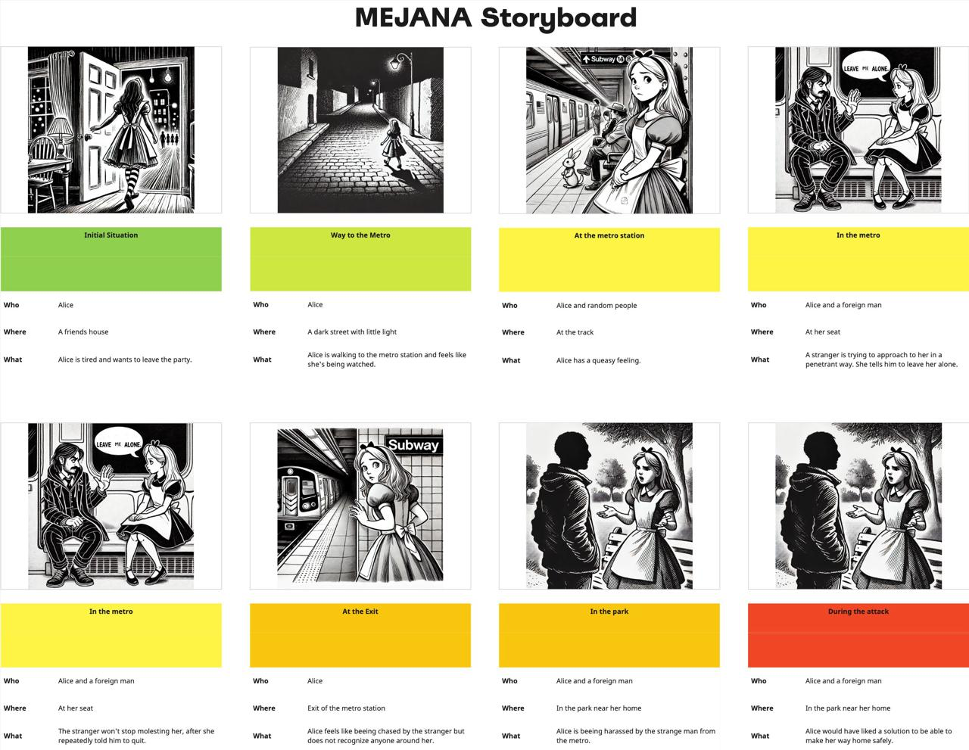
PROBLEM

Slide 4
PROBLEM
Interview Results
3
2
4
1

Slide 5
SOLUTION
Mobile safety app for emergency
Provide protection in moments of uncertainty
App is triggered by strong vibrations or shocks
Ensures automatic activation when the user might not be able to manually respond.
Sharing the location with friends, family, or security services
Integration of real-time data sources
Integration of medical pass

Slide 6
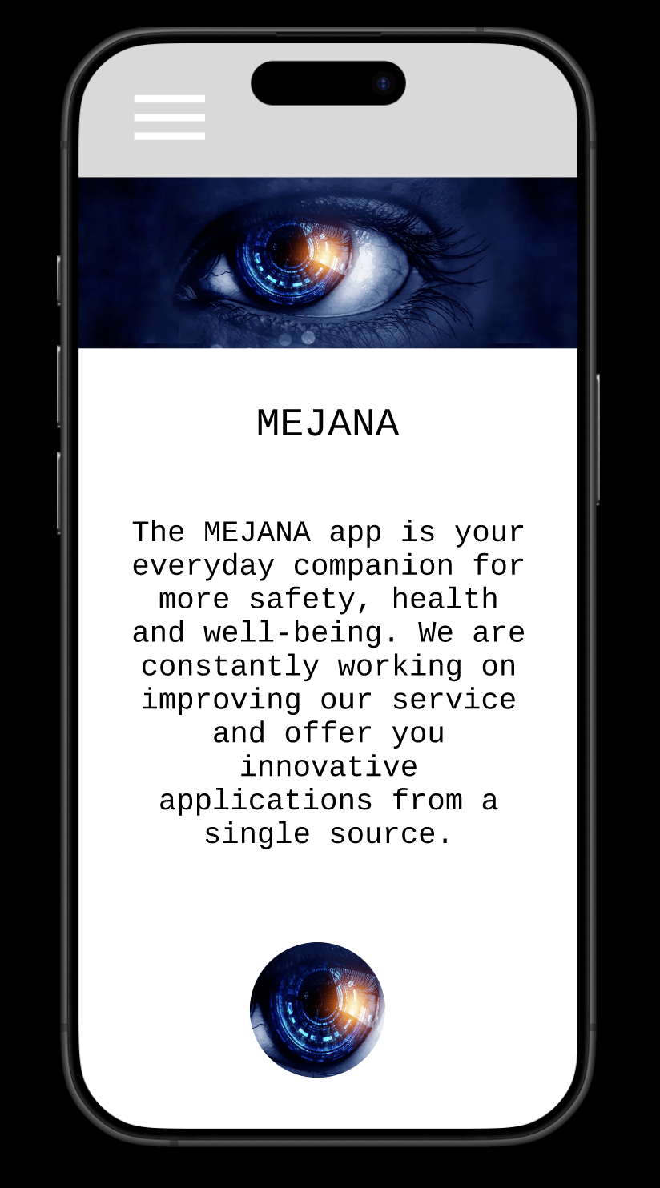
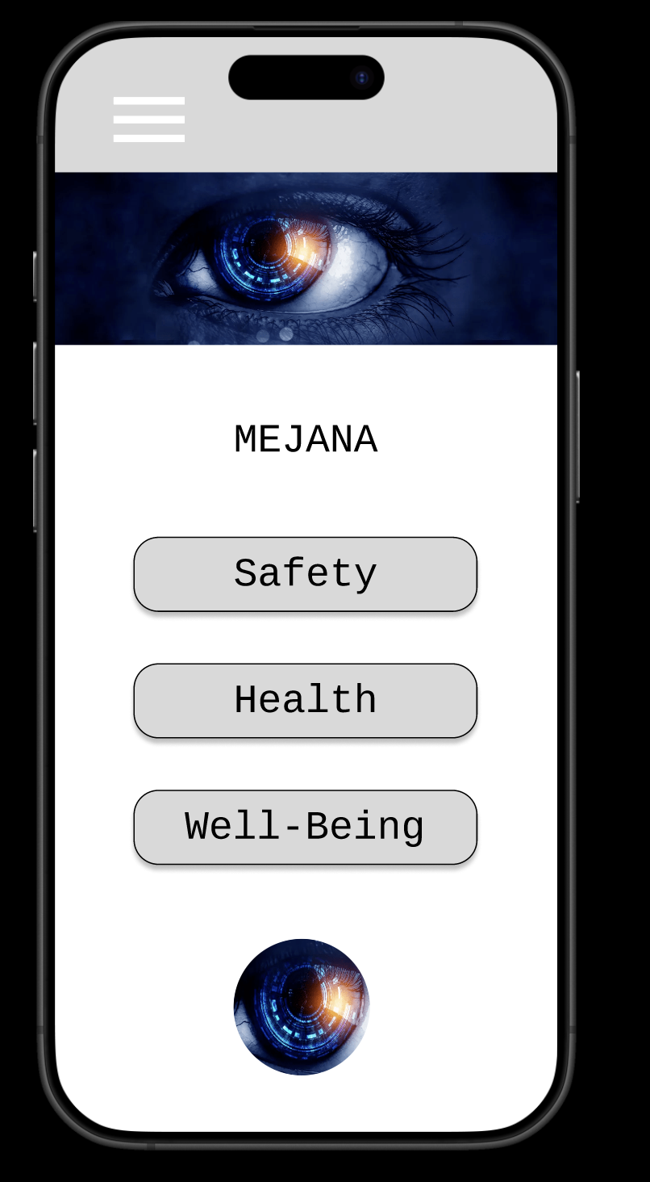
PROTOTYPE
FamilyID=Office_ArchiveTorn
Notes:
This is what our prototype looks like.
Functionality paried with a futuristic look and charisma.
simple, clear and fascinating
The landing page is on the left side
To the right of it is the start menu
Navigation is possible via a hamburger menu
Safety, Healt and Well-Beeing form our three base tabs
All App's functions and features can be found within these basic tabs
We intend to developed and improve these tabs further over time

Slide 7
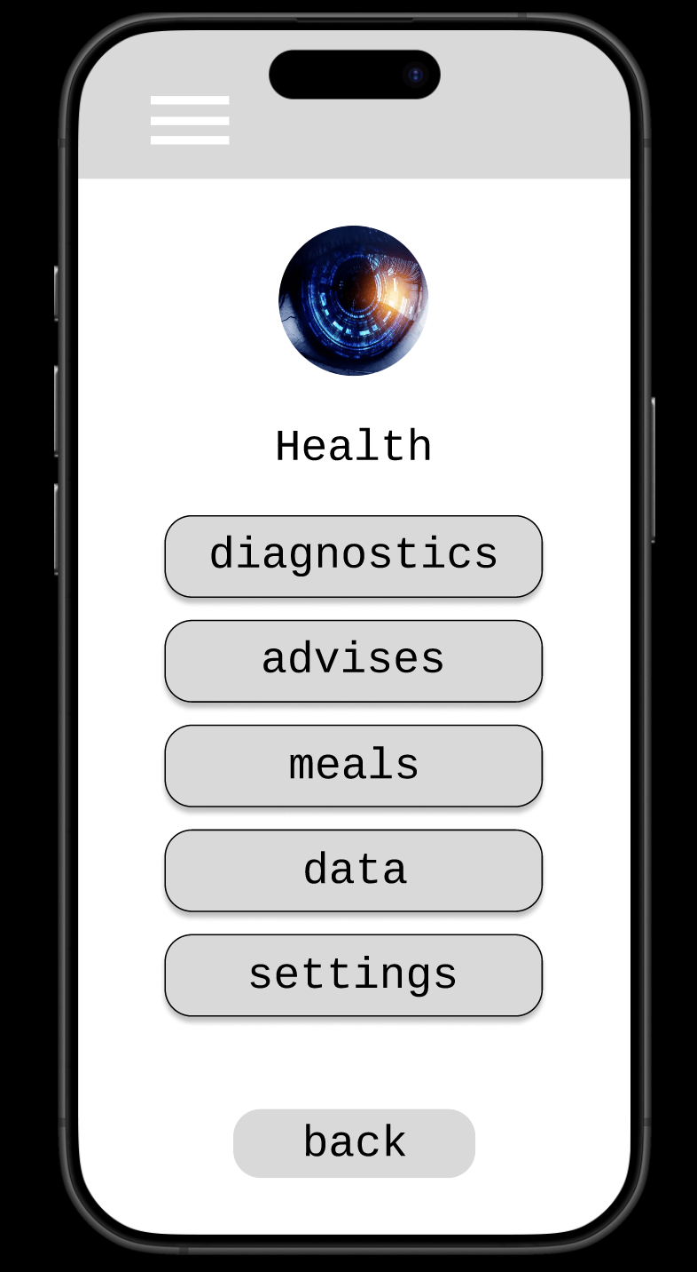
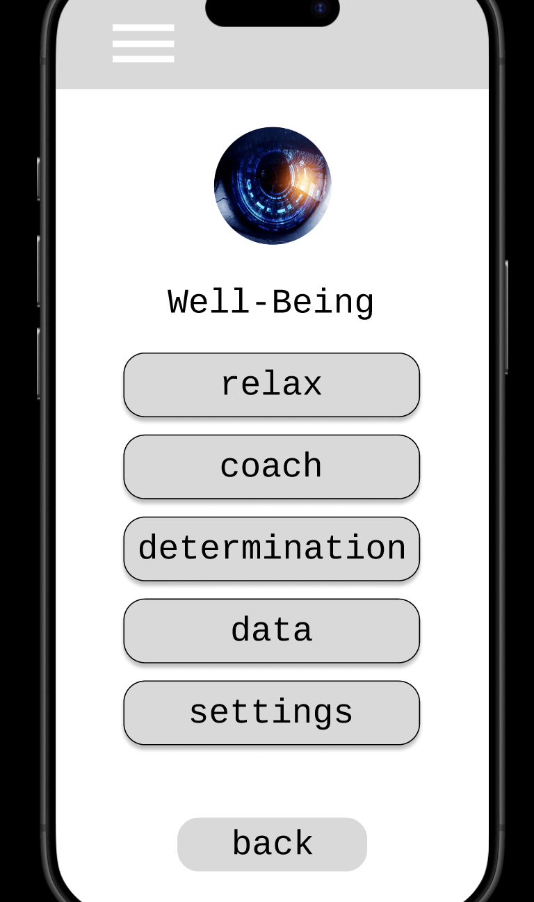
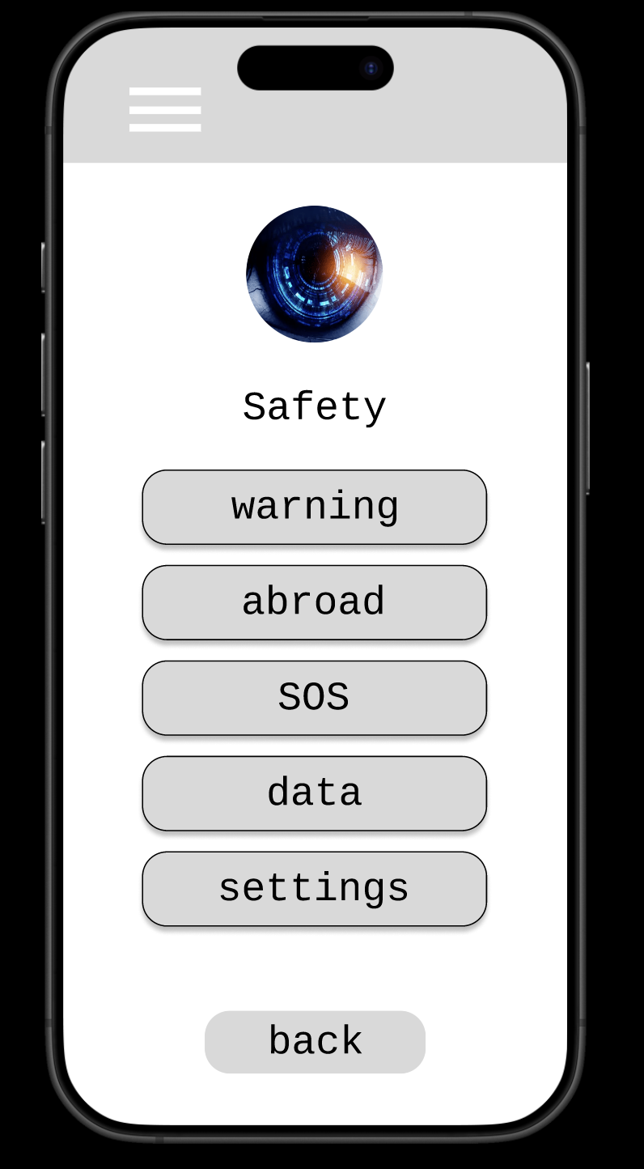
Notes:
The Healt-tab offers features like
diagrostics
advises
and meals
you can enter your individual data by answering questions and giving personal details concerning you healt
you get advises in order to improve your individual healt
and you can also get recommendations regarding meals that can improve you healt
Within the tab Well-Beeing
you can find features like
relax
coach
and determination
this is to determine you actual state of well-beeing and especially to improve it by
using the coach or relax-instructions
The Safety-tab offers features like
warning in real time in case of attacks
you can get important information if you go abroad (country-specific)
(how to behave and necessary things to keep in mind)
SOS-function

Slide 8
VALIDATION OF PROBLEM SOLUTION FIT
Customer surveys
Evaluation of the survey with numerical values
Hypothesis testing
Define a hypothesis on how the solution solves the problem and test it through experiments
Prototyping
Create a prototype and check, if it fulfills customer needs
Usability testing
Monitor customers while using the product and evaluate
Competition analysis
Examine existing products and their solution to the problem. Determine if there are gaps that your solution could address better
Compare the products → Benchmarking, SWOT, MDCA or experiments
Notes:
To Validate our product we have decided to chose 3 methods.
- the first method is „customer surveys“ where we want to ask precise questions. The customers can cross values from 1 to 5 according to how good our solutions is helping. At the end we can evaluate each survey with a
total score.
- our next method would be to create a prototype. We would like to run several tests (like funcitional and usability tests) on the prototype to check if it fulfills the customer needs.
- As a third method we chose a competition analysis, where we would like to examine existing products and compare them to ours. Here a Benchmark, SWOT or Multi-Criteria Decision Analysis could help.

Slide 9
THANKS

